Slide 1
Stack Management Tips
UFCFWK-15-2 Operating Systems
Jonathan White
Lecturer in Cyber Security​
​
Jonathan6.White@uwe.ac.uk​
4th December 2021

Slide 2
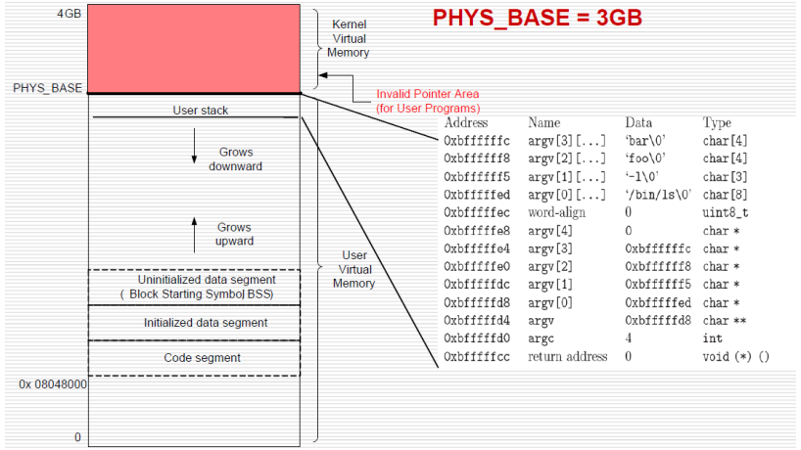
Building the stack:
argv’s
Padding (if required)
NULL
Address of each argv
Pointer to argv addresses
argc
Stack return address. 0 for first call
Figure: An example stack for the command “/bin/ls –l foo bar”

Slide 3
Setup Stack
setup_stack() currently takes the parameter void** esp which is the stack pointer. Feel free to add more arguments and pass in additional information
No need to modify existing setup_stack() code other than to remove the -12 we added in Worksheet 3. Add your additional functionality at the bottom of the function.
void** esp will be initialised with PHYS_BASE which is the top of the stack.
You will need to incrementally move the pointer backwards in memory and write data to the pointer. As it’s a stack, everything will be written in reverse order so decrement the stack pointer before writing to it.

Slide 4
Setup Stack – General Steps
Parse the filename delimiting by white spaces. Notice that setup_stack() doesn’t have access to the filename. You’ll need to find a way to pass that information into this function. Parsing the filename can easily be done with strtok_r().
Write each argument (including the executable name) in reverse order, as well as in reverse for each string, to the stack. Remember to write a \0 for each argument. memcpy() will come in handy here.
Write the necessary number of 0s to word-align to 4 bytes. A little modulus math and memset() will get the job done.

Slide 5
Setup Stack – General Steps
Write the last argument, consisting of four bytes of 0’s.
Write the addresses pointing to each of the arguments. You’ll need to figure out how to reference the addresses after writing all the arguments. These are char*’s.
Write the address of argv[0]. This will be a char**.
Write the number of arguments (argc). Make sure that this spans over 4 bytes.
Write a NULL pointer as the return address. This will be a void*.

Slide 6
Setup Stack – General Steps
It will be a good idea to use hex_dump() to check the correctness of your stack after each and every step in order to avoid a debugging mess.
Example stack for “echo x y z”

Slide 7
References:
Pinots User Programs: https://web.stanford.edu/class/cs140/projects/pintos/pintos_3.html#SEC32
Pintos Reference Guide: https://web.stanford.edu/class/cs140/projects/pintos/pintos_6.html
Pintos Guide: https://static1.squarespace.com/static/5b18aa0955b02c1de94e4412/t/5b85fad2f950b7b16b7a2ed6/1535507195196/Pintos+Guide

